Slide 1


Status of Semi-Digital Hadronic Calorimeter (SDHCAL)
Haijun Yang (SJTU)
(on behalf of the CALICE SDHCAL Group)
International Workshop on CEPC
IHEP, Beijing, November 6-8, 2017

Slide 2
Outline
SDHCAL Technological Prototype
Description
Test Beam Results
Hadronic Shower Studies
R&D for Large SDHCAL Modules
Detectors
Electronics
DAQ
New Challenges
Summary and Conclusion

Slide 3
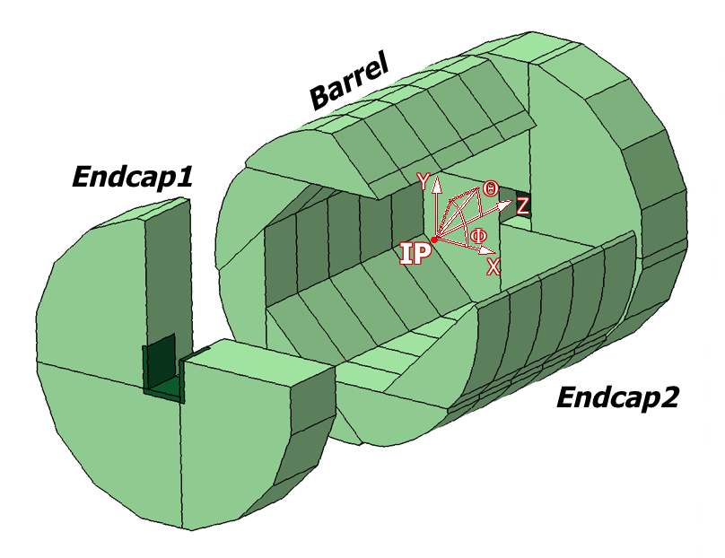
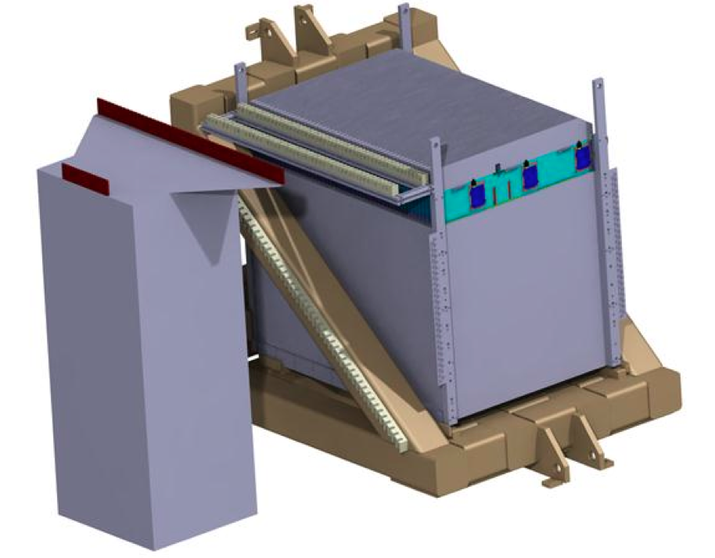
SDHCAL for ILD
The SDHCAL-GRPC is one of the two HCAL options based on PFA and proposed for ILD. Modules are made of 48 RPC chambers (6λ_{I}), equipped with semi-digital, power-pulsed electronics readout and placed in self-supporting mechanical structure (stainless steel) to serve as absorber.
Proposed structure for SDHCAL-ILD:
Very compact with negligible dead zones
Eliminates projective cracks
Minimizes barrel and endcap separation
SDHCAL prototype should be able to study hadronic showers and very close to ILD module
Challenges:
Homogeneity for large surfaces
Thickness of only a few mm
Lateral segmentation of 1cm X 1cm
Services from one side
Embedded power-cycled electronics
Self-supporting mechanical structure

Slide 4
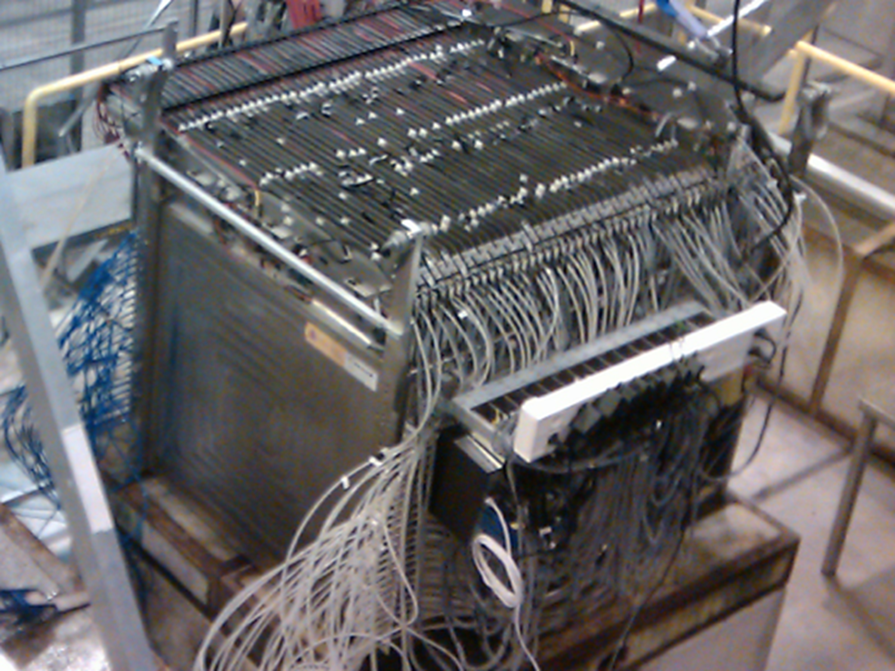
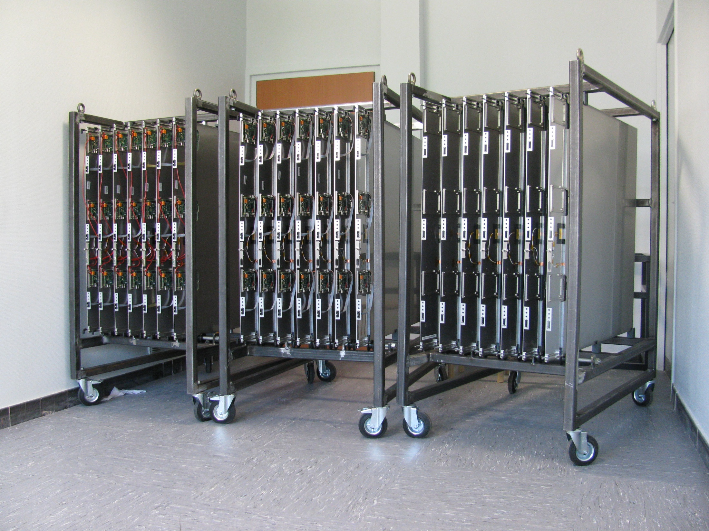
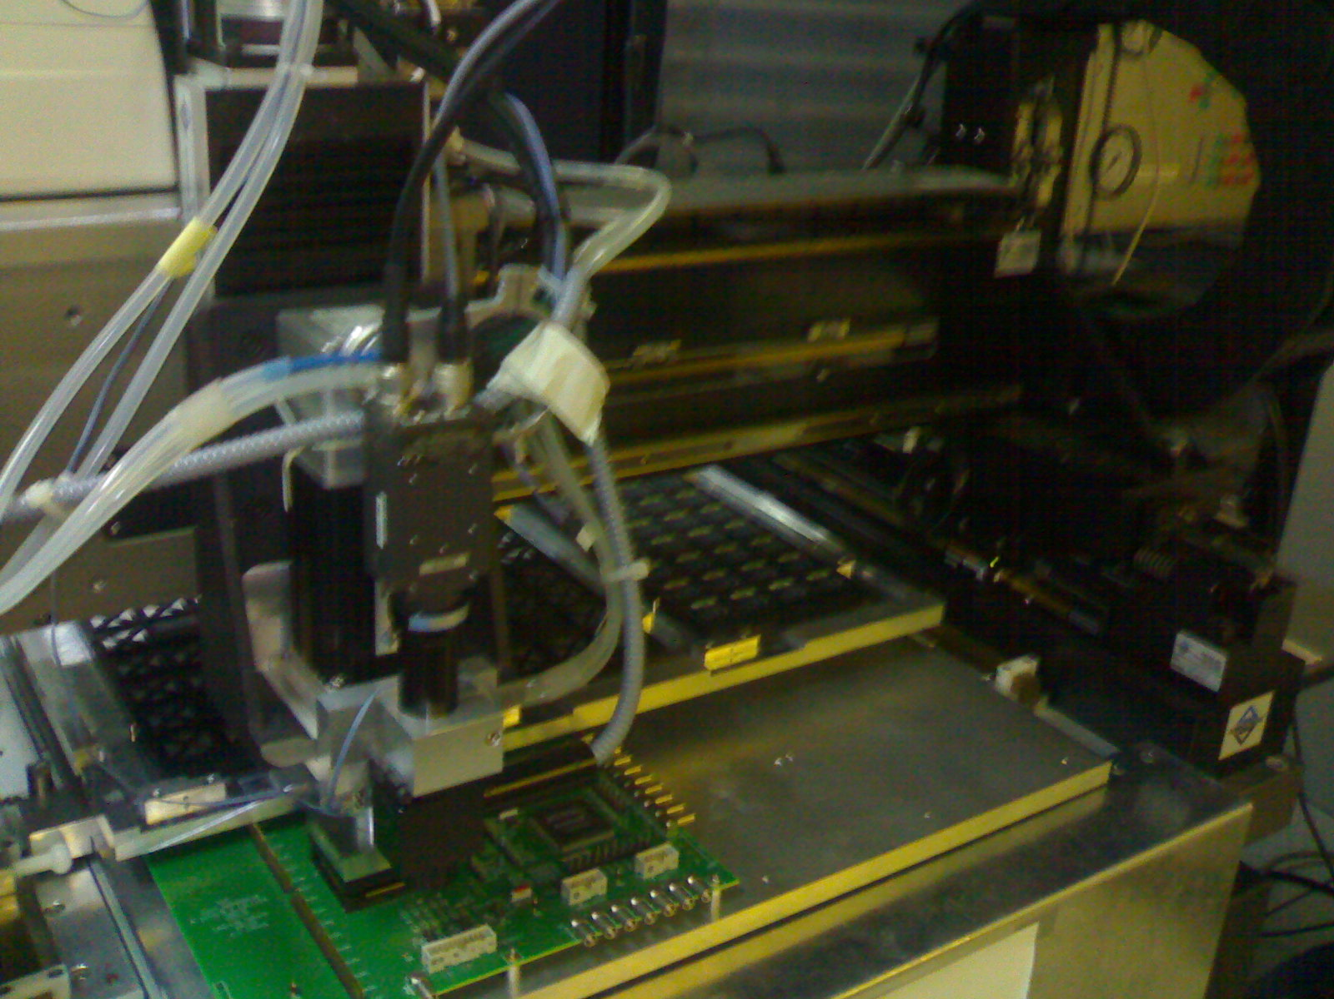
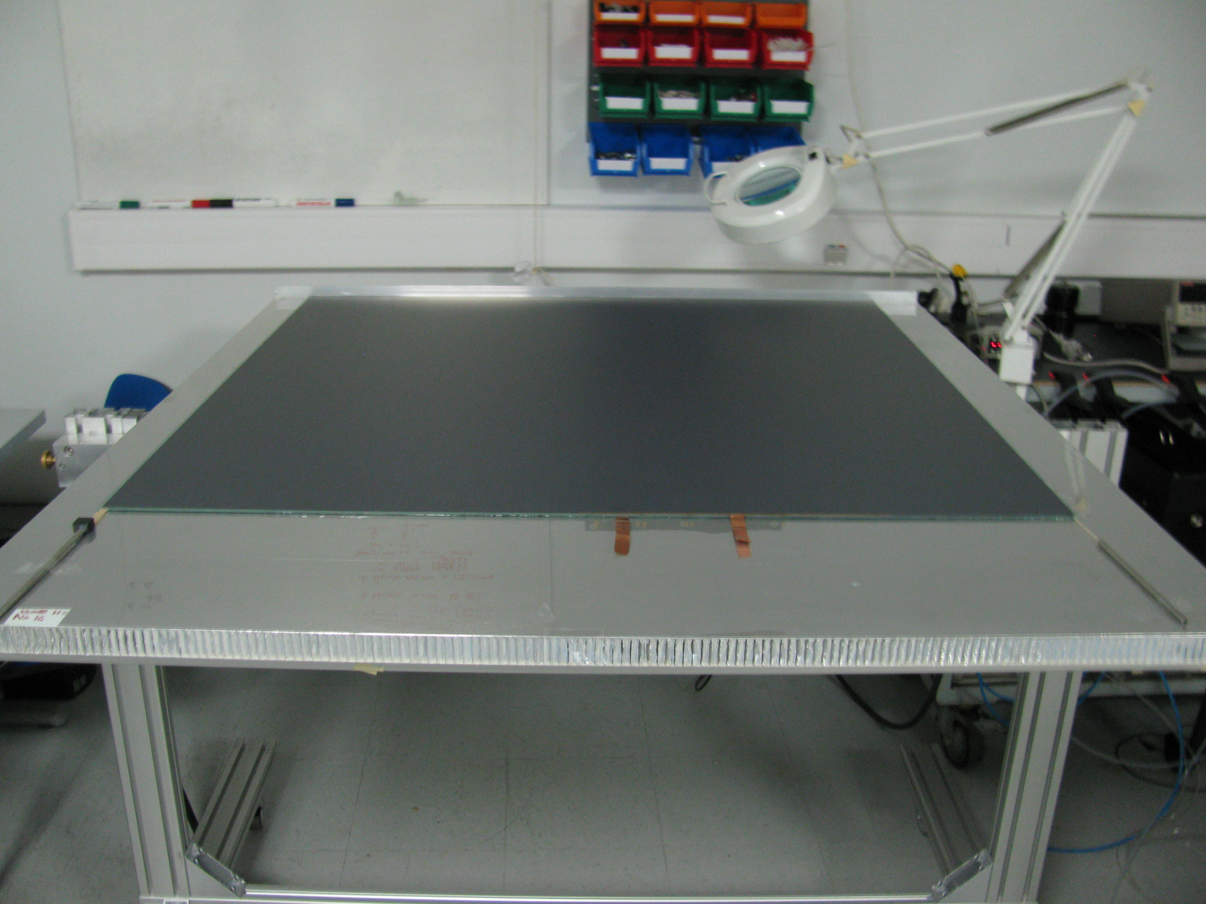
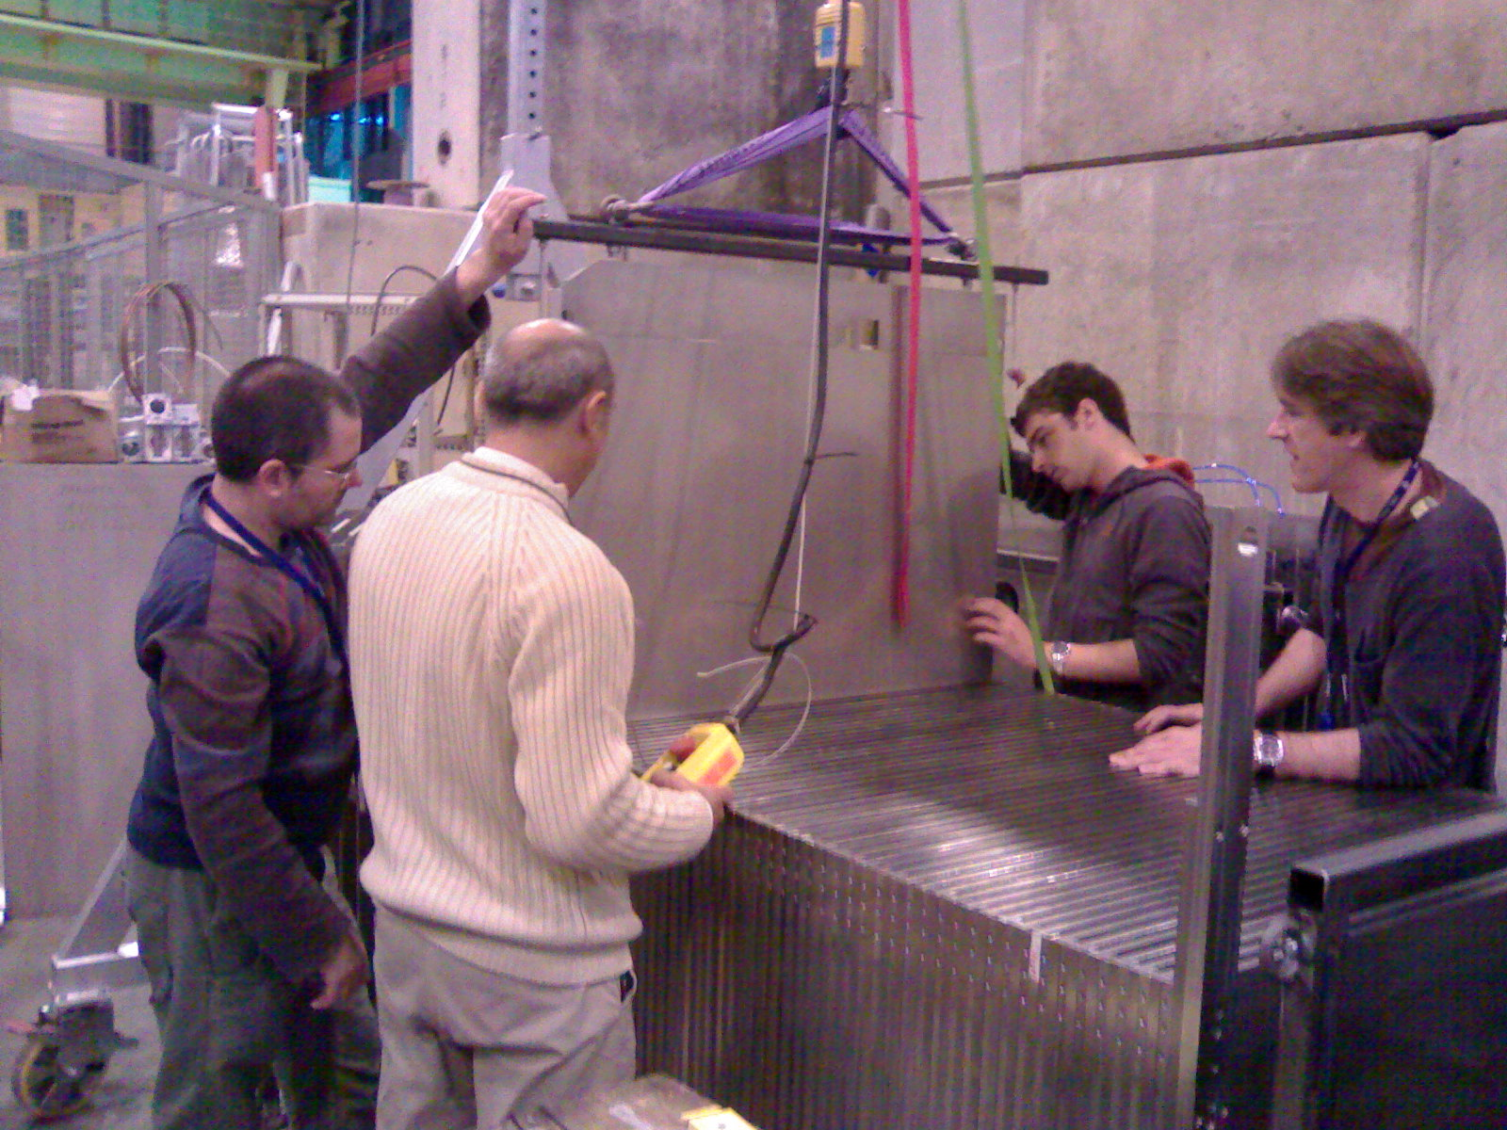
SDHCAL Prototype Construction
10500 64-ch ASICs were tested and calibrated using a dedicated ASICs layout ( 93% ).
310 PCBs were produced, cabled and tested, assembled by sets of six to make 1m² ASUs
170 DIF, 20 DCC were built and tested.
50 detectors were built and assembled with electronics into cassettes.
DAQ system using both USB and HTML protocol
was developed and used.
Self-supporting mechanical structure.
Full assembly took place at CERN.
JINST 10 (2015) P10039

Slide 5
SDHCAL Performance
The SDHCAL prototype was exposed to hadron, muon and electron beams
in 2012, 2015 and 2016 on PS, H2, H6 and H8-SPS lines.
Power-pulsing using the SPS spill structure was used to reduce the power consumption.
Self-triggering mode is used but external trigger mode is possible
The threshold information helps to improve on the energy reconstruction by better
accounting for the number of tracks crossing one pad
New data were taken in 2015, 2016 and 2017 with an
improved DAQ system
Hit time spectrum
for 40 GeV pion
Noise Hits

Slide 6
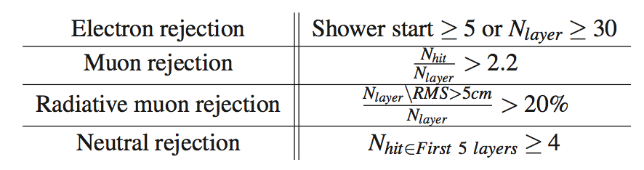
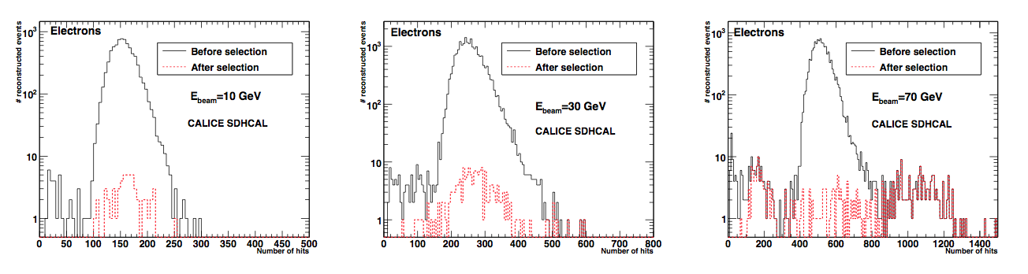
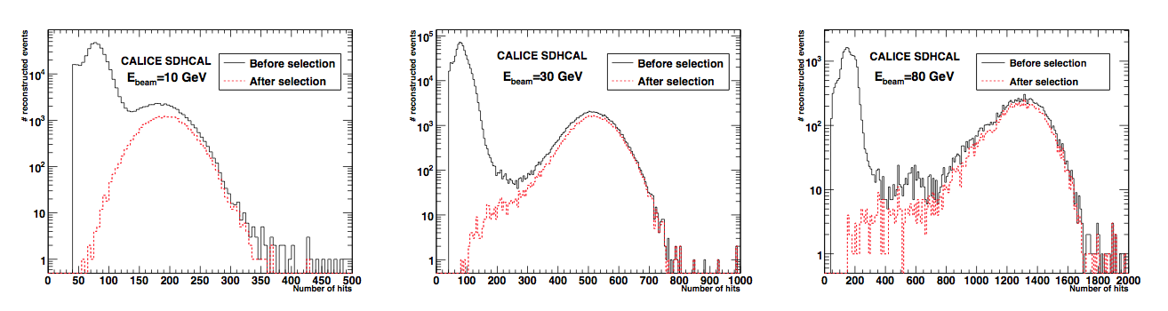
Event Selection of Hadron Beams
No containment selection.
No Cerenkov detector
Triggerless mode
Power pulsed mode

Slide 7
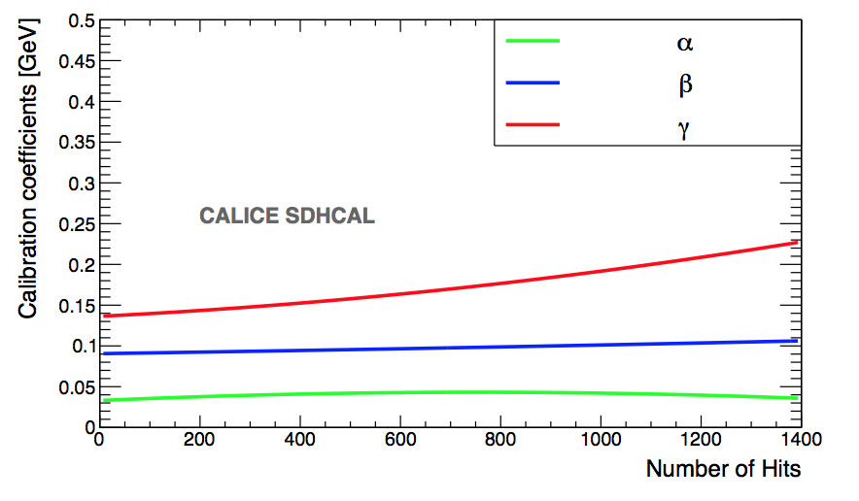
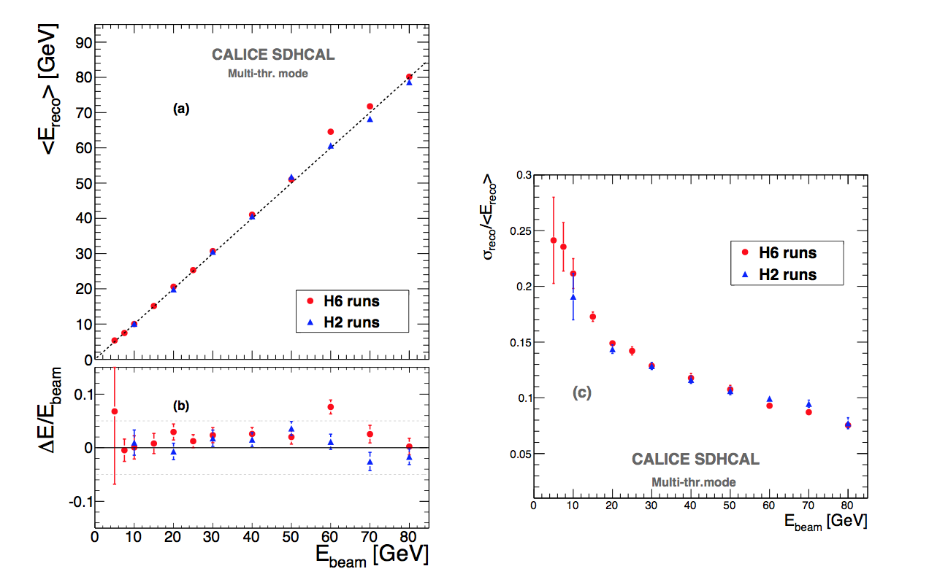
Energy Estimation
The thresholds weight evolution with the total number of hits obtained by minimizing a χ² , Χ² = (E_{beam}-E_{rec})²/E_{beam}
E_{rec =} α (N_{tot}) N₁ + β(N_{tot}) N₂ + γ(N_{tot}) N₃
N₁,N₂ and N₃ : exclusive number of hits associated to first,
second and third threshold.
α, β, and γ : quadratic functions of total number of hits (N_{tot})
- Events of H2 runs corresponding to energies :
5, 10, 30 , 60, 80 GeV were used to fit the 9 parameters.
- Then the energy of hadronic events in both
H2( only pions) and H6 (presence of protons)

Slide 8
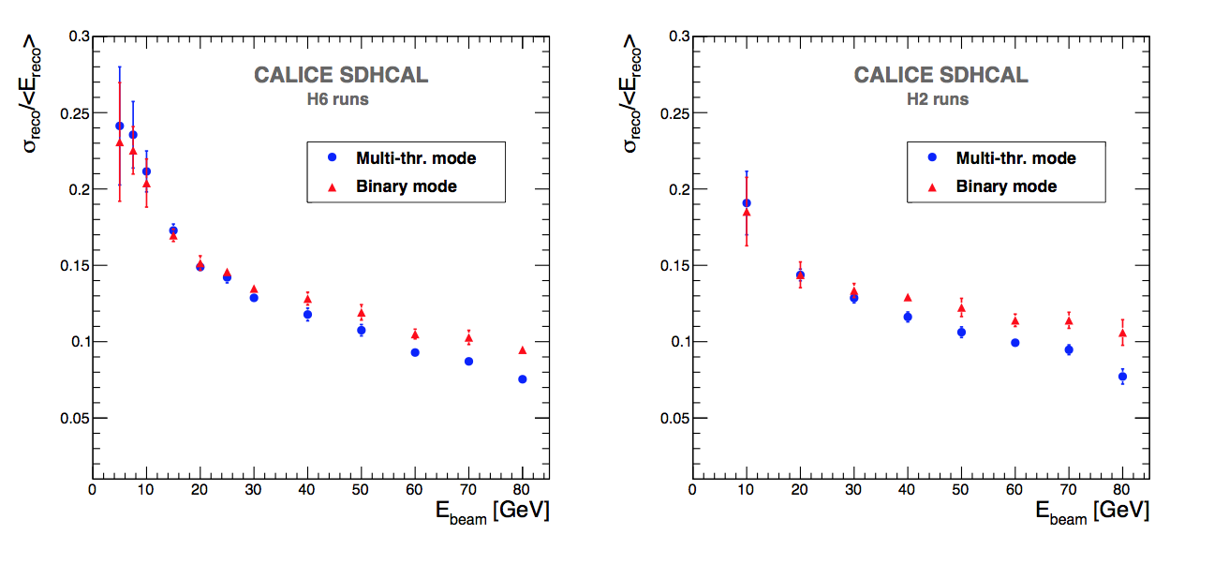
Energy Estimation
Comparison of semi-digital versus binary readout
E_{rec} (binary) = C N _{tot} + D N² _{tot} + F N³_{tot}
E_{rec} (semi-digital) = α (N_{tot}) N₁ + β(N_{tot}) N₂ + γ(N_{tot}) N₃
JINST 11 (2016) P04001
➔ Substantial improvement for beam energy > ∼ 40 GeV

Slide 9
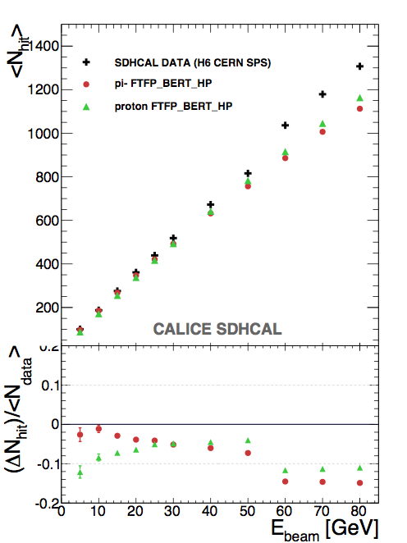
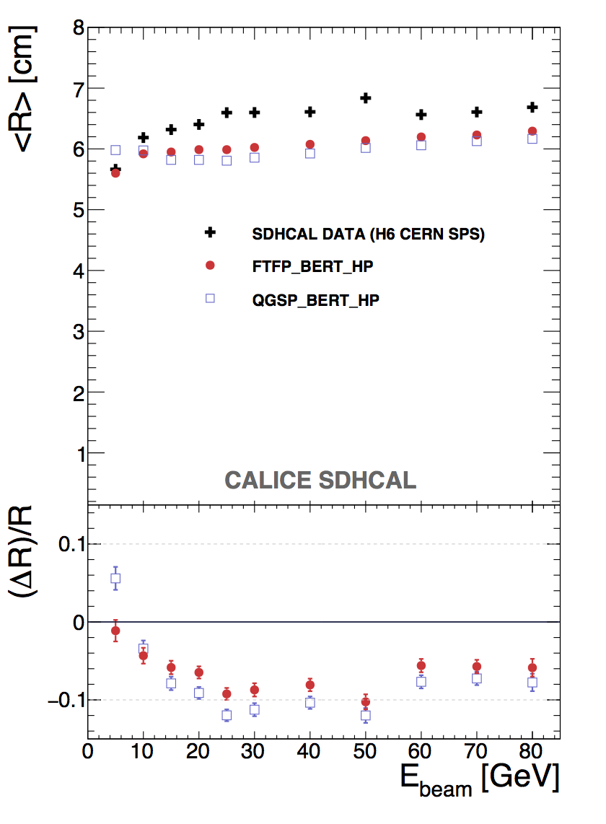
Data vs MC
JINST 11 (2016) P06014
Hadronic shower is more compact in MC than in data

Slide 10
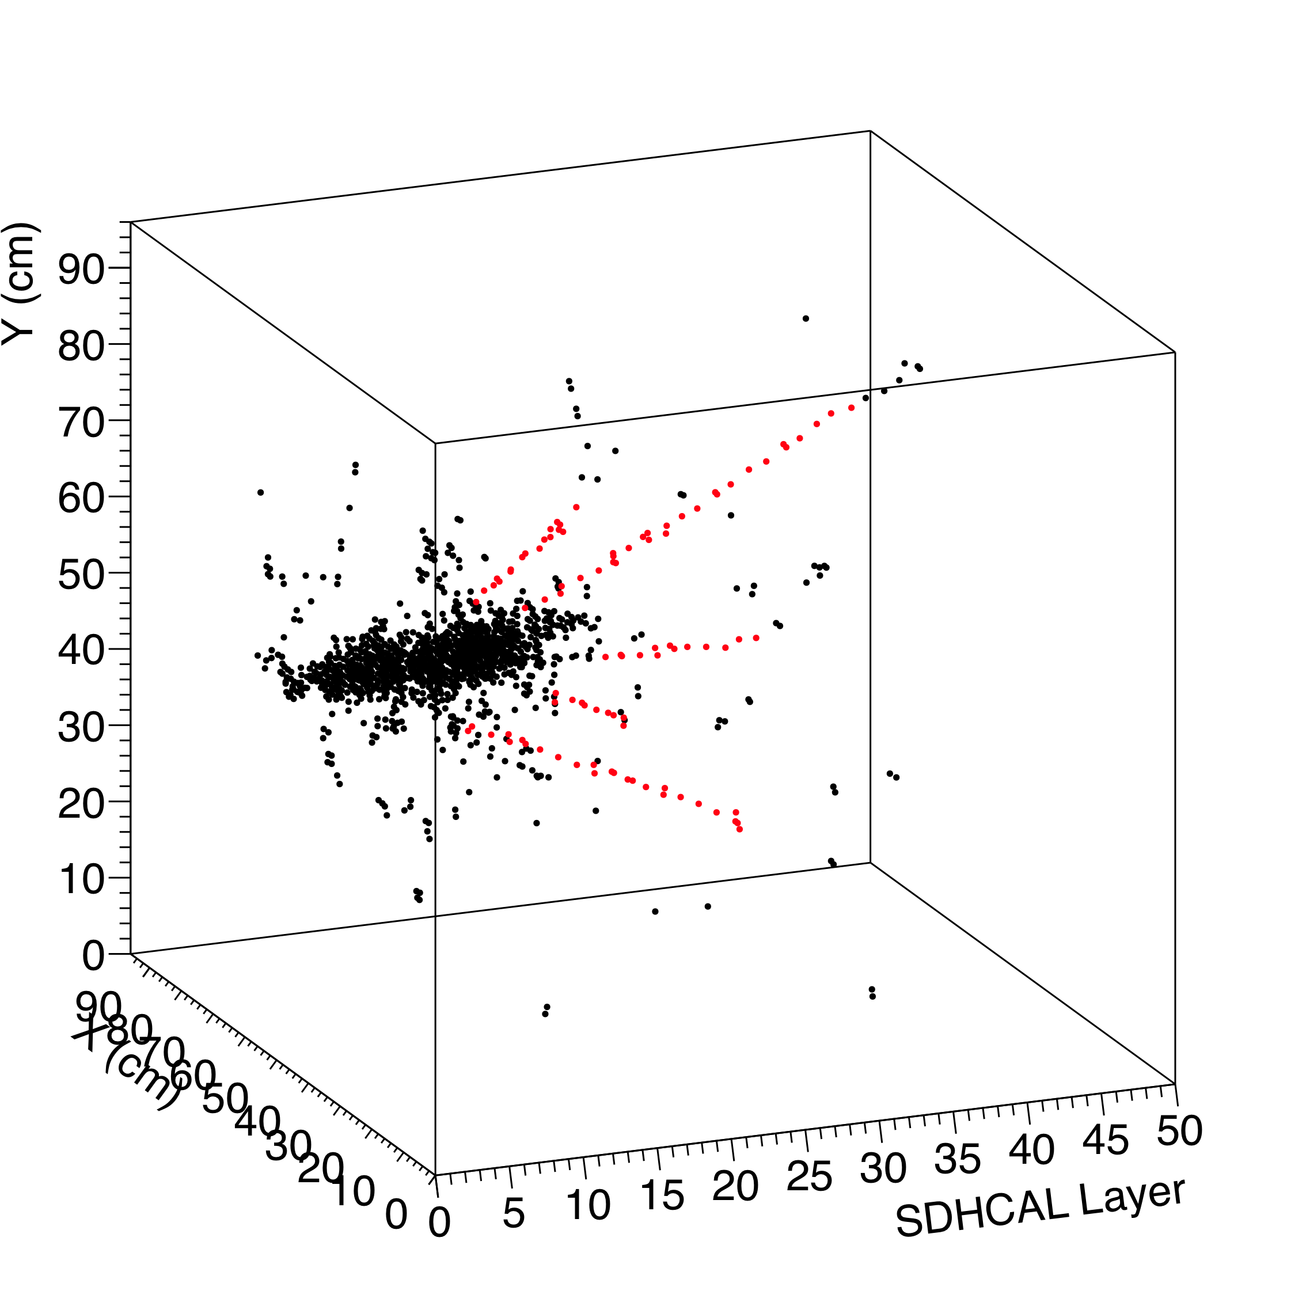
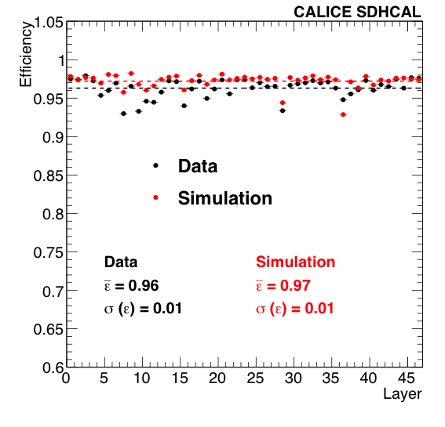
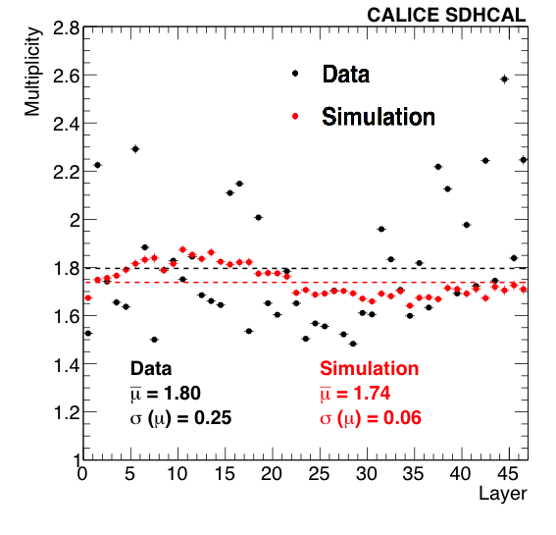
Data vs MC
SDHCAL High-granularity impact
Hough Transform is an example to extract tracks
within hadronic showers and to use them to
control the calorimeter in situ
40 GeV pion
Excellent data/MC agreement for
efficiency and multiplicity obtained with
cosmic muons and test beam muons.
40 GeV pion
80 GeV hadron

Slide 11
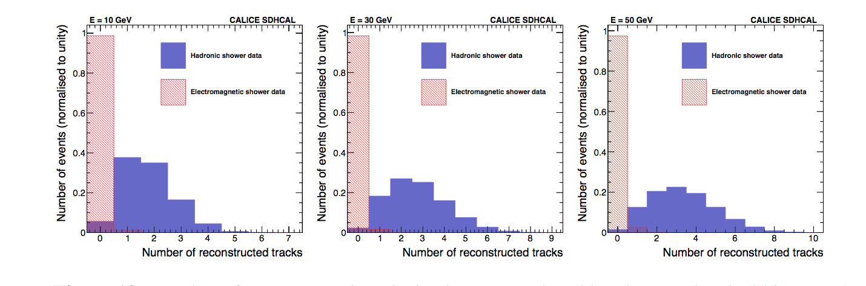
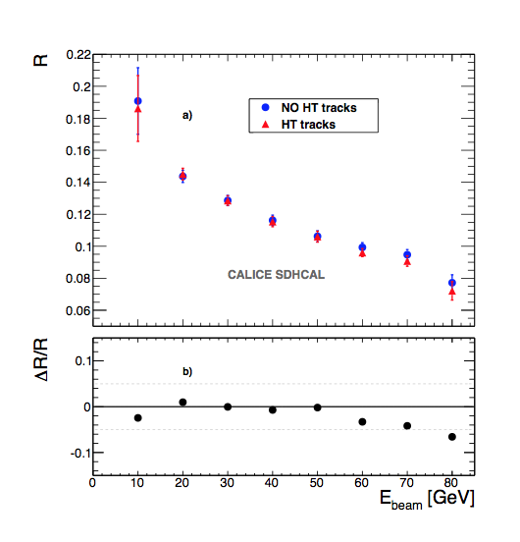
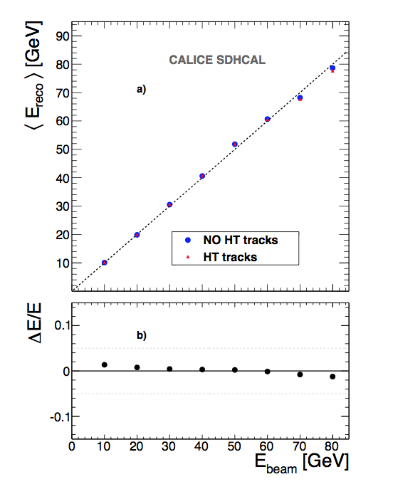
Separation of electron/hadron
10 GeV
30 GeV
80 GeV
It improves on the energy reconstruction by dealing with the hits belonging
to the track segments independently of their threshold.
The technique could be
extended to hadronic showers in magnetic field.
Energy Resolution
JINST 12 (2017) P05009

Slide 12
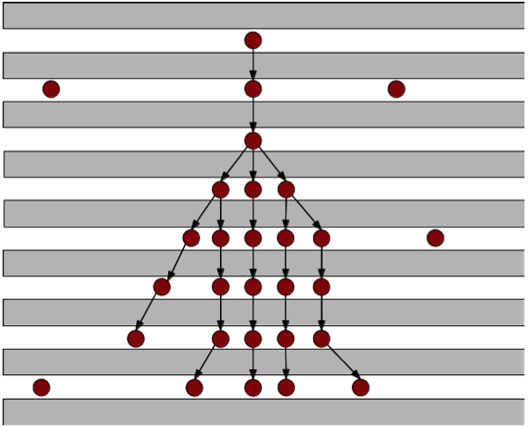
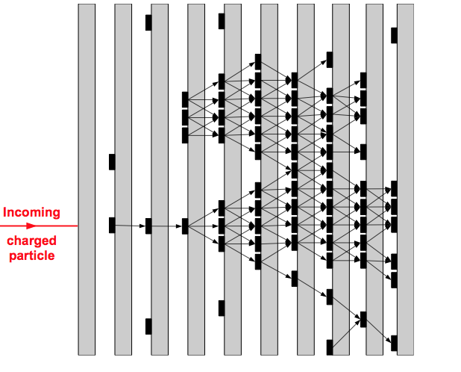
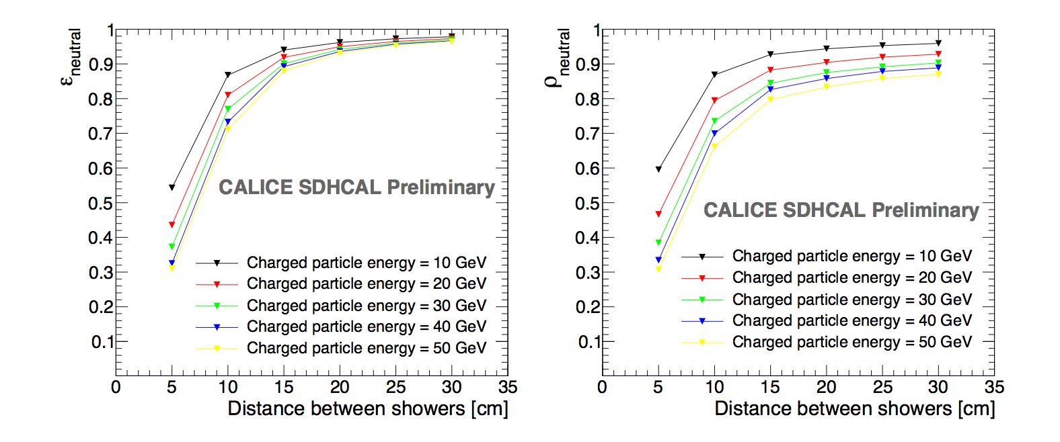
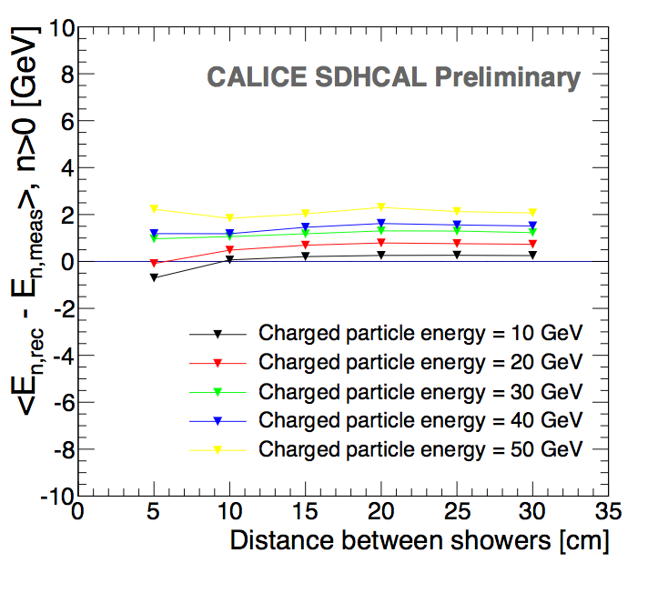
Arbor PFA
CALICE note CAN054
SDHCAL high granularity is desirable
It helps to optimize the connection of hits belonging to the same shower
by using the topology and energy information
ArborPFA algorithm:
It connects hits and clusters using distance and orientation information, then correct tracker momentum information.
Efficiency
Purity

Slide 13
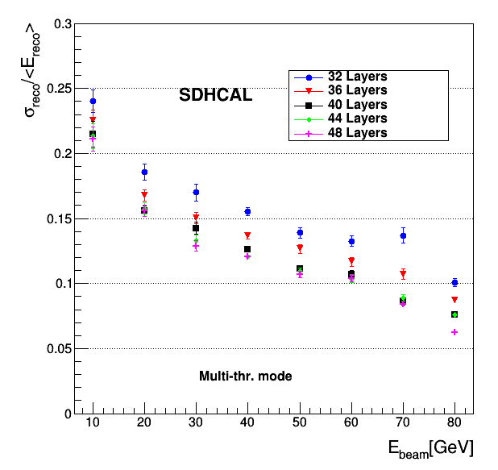
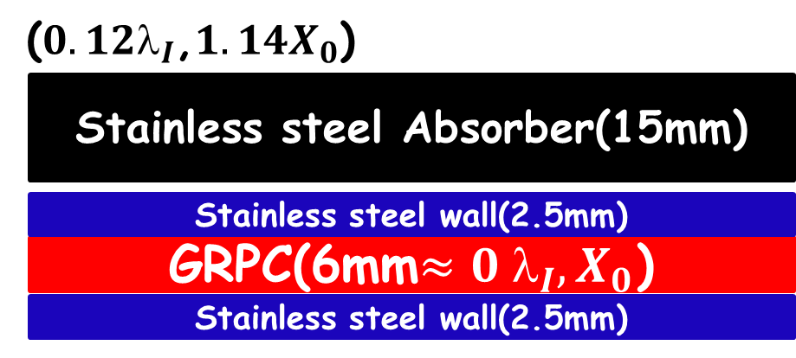
Energy Resolution vs No. of Layers
➔SDHCAL has 48 layers which
aims for ILC Detector
6mm gRPC + 20mm absorber
Optimization no. of layers for CEPC at 240GeV
➔40-layer SDHCAL yields decent
energy resolution.

Slide 14
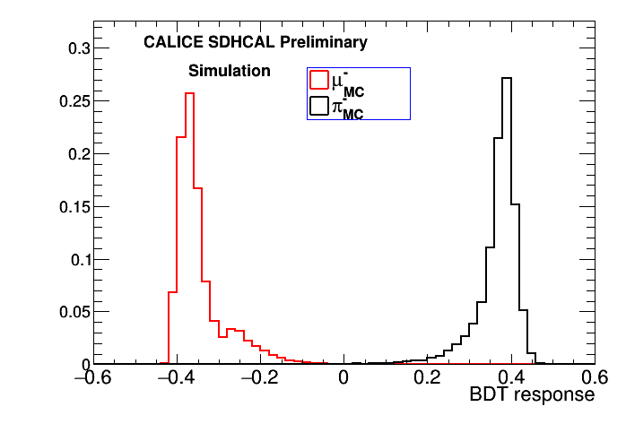
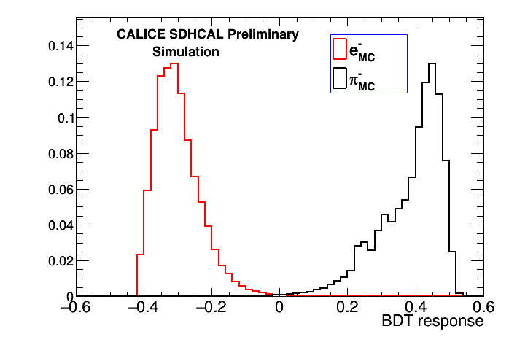
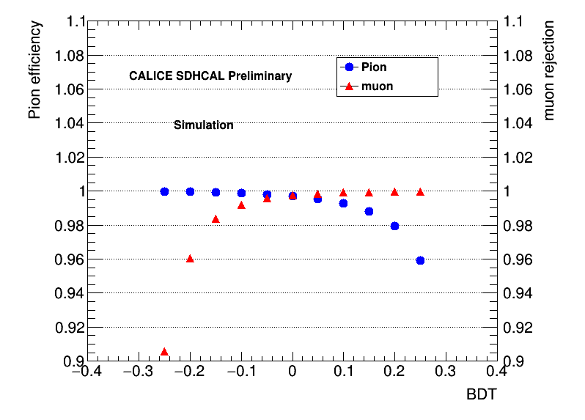
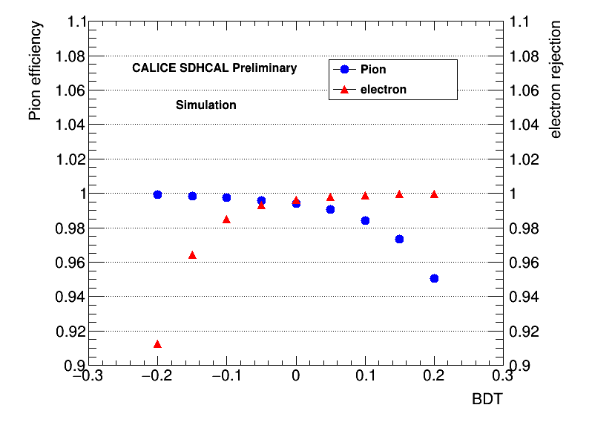
BDT for pion/e, mu Identification
muon
pi
e-
pi

Slide 15
Pion eff. vs Backgrounds eff.
For same Pion efficiency, we compare electron & muon efficiencies from “simple cut” and “BDT” methods.
BDT has modest improvement for electron suppression and significant improvement for muon suppression.
CALICE note CAN059

Slide 16
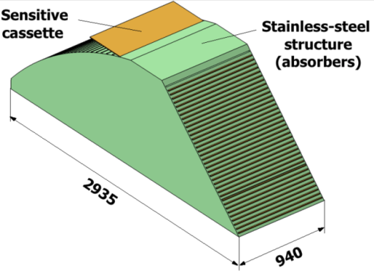
SDHCAL for Future Experiements
Detectors as large as 3m X 1m need to be built
Electronic readout should be the most robust with
minimal intervention during operation.
DAQ system should be robust and efficient
Mechanical structure to be similar to the final one
Envisage new features such as timing, etc..
GRPC
Glass Resistive Plate Chambers
SDHCAL
ILD Module
Goal: to build new prototype with few but large GRPC
and new components → ILD Module0

Slide 17
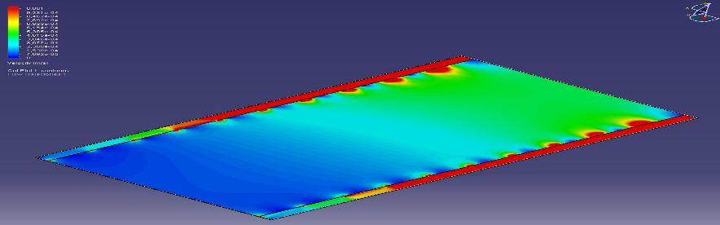
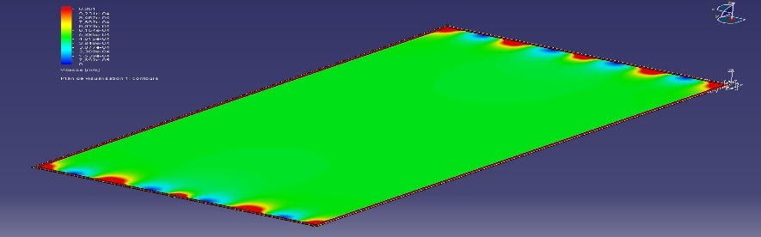
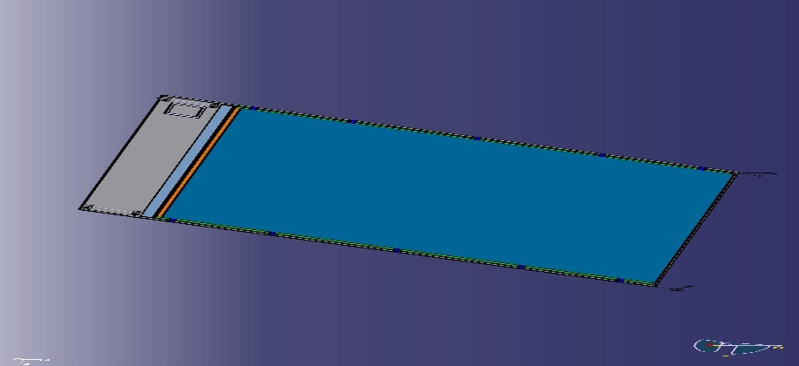
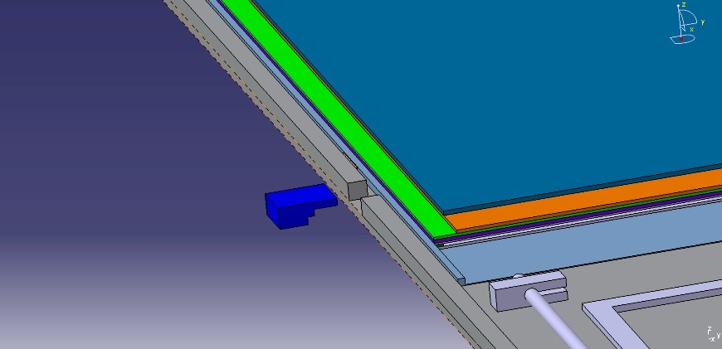
Detector Conception
Construction and operation of large GRPC need some improvements with
respect to the present scenario. Gas distribution : new scheme is proposed
Prototype circulation system
New circulation system
inlet
outlet
1 m
2 m
Cassette conception to ensure good contact between the detector and electronics is to be improved
Construction of a few large RPCs has started

Slide 18
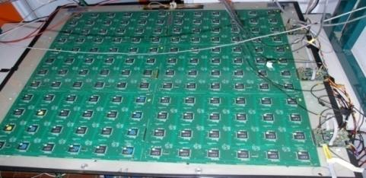
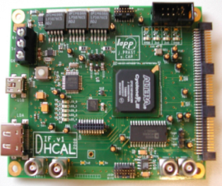
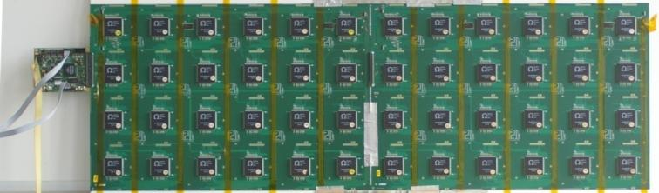
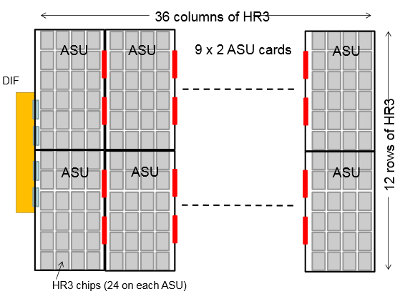
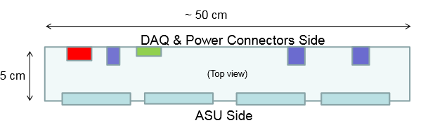
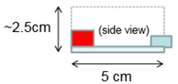
New Electronics
Electronics readout for the 1m³ prototype
HADROC chip
(ASIC)
1m² board ➔ 6 ASUs hosting 24 ASICs
3072 ch
DIF #1
144 ASICs= 9216 channels/1m²
USB
ASU1
ASU2
33 cm
DIF #2
HDMI
DIF
100 cm
DIF #3
1 DIF (Detector InterFace) for 2 ASU (Active Sensor Unit.- PCB+ASICs) ➔ 3 DIFs for ONE 1m² GRPC detector
Electronics readout for the final detector
Only 1 DIF per GRPC (any size) with small dimensions to fit in the small space available at the ILD detector
DIF dimensions

Slide 19
DAQ System
Implementation of a GBT-based communication system for ROC chips. This aims to reach higher performance using robust and well maintained system in the future
Global system architecture
Front-End control and data collection
SLC
Async cdes
PC
data
GLIB
DIF
Roc based ASU
gEth
GBT
For now, KC705
HR2, HR3, Petiroc..
GLIB
PC
GBT
gEth
Clk
Sync cdes
Veto, trg
Clocking and main FSM

Slide 20
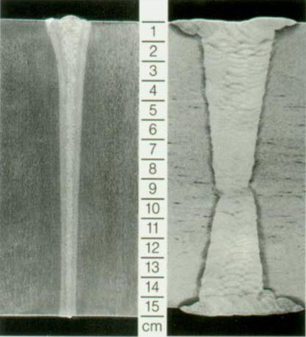
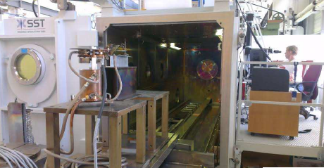
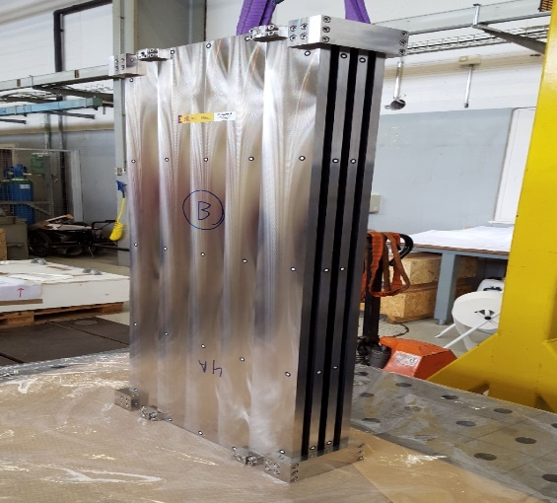
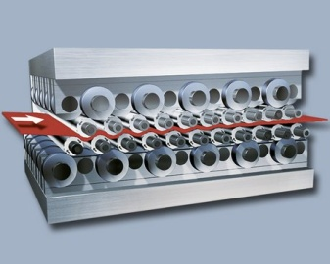
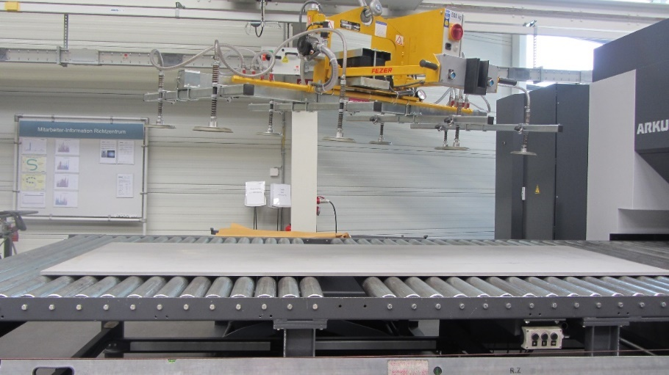
Mechanical Structure
Improvement on the present system is being made by using Electron Beam Welding rather than bolts to reduce the deformation and the spacers thickness.
Industrial production of flat large absorber plates (3 m X 1 m) by roller leveling process

Slide 21
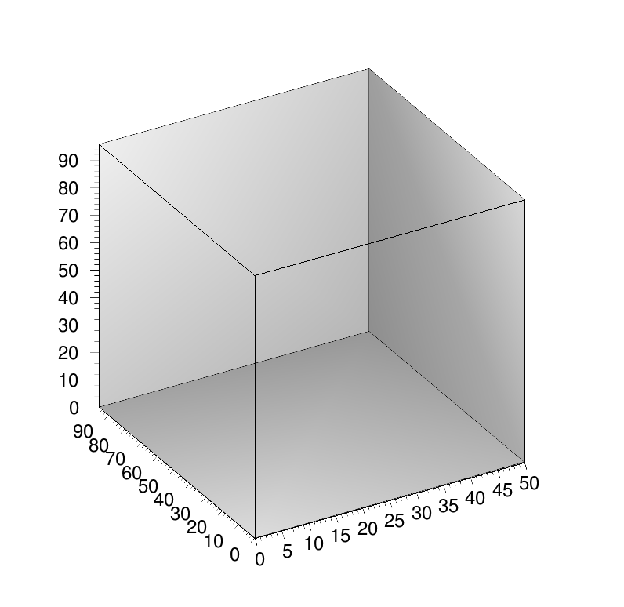
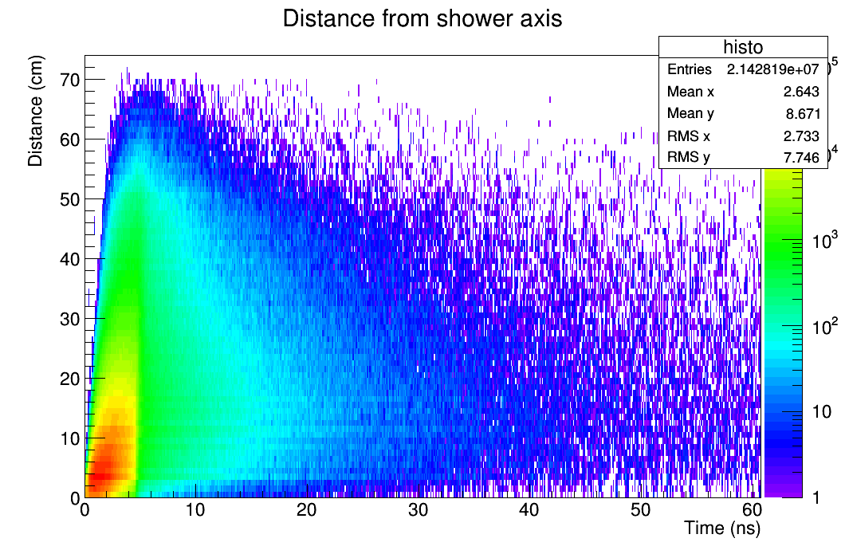
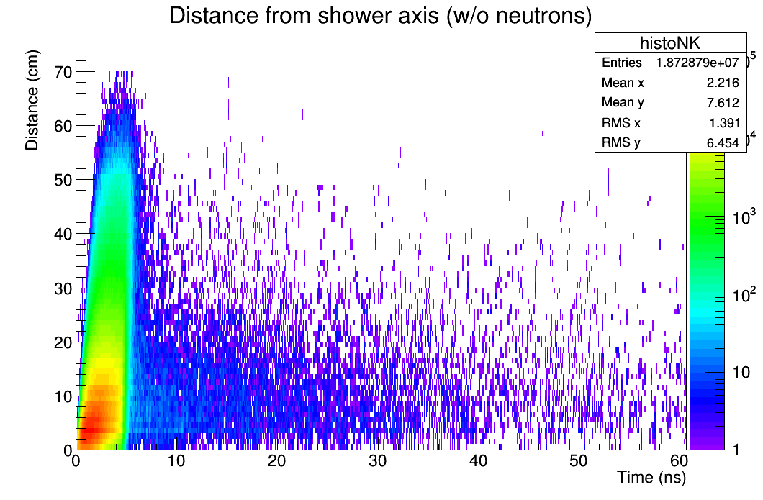



Next Step: Better Timing
Timing could be an important factor to separate showers and better reconstruct their energy
Multi-gap RPC are excellent fast timing detectors
Several MRPC were designed and built . Excellent efficiency when tested with HARDROC ASICs.
Next step use PETIROC (< 20 ps time jitters) to single out neutron contributions.

Slide 22


Next Step: Cooling
Cooling becomes necessary if the power-pulsing scheme is not possible (CEPC project)
1.5 m
0.5 m
108 chips
Rectangular section tubes : 2x1 mm
Copper plate over: 1.5 mm
Flow out
symmetry
Flow in
PCB plate under: 1.4 mm
symmetry
Water cooling :
h = 10000 W/m²/k
Thermal load :
80 mW/chip without power pulsing
27.147 (max) – 24.591 (min) =2.556 ºC
Simulation ¼ structure PCB + Chips

Slide 23
Summary and Conclusion
SDHCAL (since 2011) is the first technological and still the unique complete prototype built for future experiments.
Results of beam tests validate the concept. Many results are obtained.
There is still a place for improvement by using genuine techniques (Hough Transform, MVA, …)
New prototype is on the rails and in principle could be achieved in 2018.
New features such as timing and cooling will play important role in future colliders R&D.
Many thanks for great efforts from CALICE SDHCAL working groups !

Slide 24
Backup Slides

Slide 25











Energy Reconstruction
Energy reconstruction formula:
$E_{reco}=αN_{1}+βN_{2}+γN_{3}$
$α,β,γ$ are parameterized as functions of total number of hits(N1+N2+N3)
$$α=α_{1}+α_{2}N_{total}+α_{3}N_{total}^{2}$$
$$β=β_{1}+β_{2}N_{total}+β_{3}N_{total}^{2}$$
$$γ={ γ}_{1} +{ γ}_{2}N_{total}+{ γ}_{3}N_{total}^{2}$$
optimizer
20GeV
40GeV
$$^{2}=\sum_{i=1}^{N}{\frac{{(E}_{beam}^{i}−E_{reco}^{i})2 }{σ_{i}^{2}}}$$
$σ_{i}=\sqrt{E_{beam}^{i}}$.
fitted with a Gaussian
Function in a 1.5$σ$ range around the mean

Slide 26



New Electronics: ASIC
HARDROCR3 main features:
Independent channels
Zero suppress
Extended dynamic range (up to 50 pC)
I2C link with triple voting for slow control parameters
packaging in QFP208, die size ~30 mm²
Consumption increase (internal PLL, I2C)
6,3 mm
4,7 mm
H3B TESTED : 786, Yield : 83.3 %
FSB2
Up to 50 pC

Slide 27


ASU (Active Sensor Unit)
One important challenge is to build a PCB up to 1m length with good planarity to have a homogeneous contact of pads with RPCs in order to guarantee an uniform response along all the detector. After investigation in some companies,
1x0.33 m2 with 13 layer ASUs have been built.
ASU
The ASU-ASU (= ASU-DIF) connections also produced

Slide 28


New Electronics: DIF
DIF sends DAQ commands (config, clock, trigger) to front-end and transfer their signal data to DAQ. It controls also the ASIC power pulsing
• Only one DIF per plane (instead of three)
• DIF handle up to 432 HR3 chips (vs 48 HR2 in previous DIF)
• HR3 slow control through I2C bus (12 IC2 buses).
Keeps also 2 of the old slow control buses as backup & redundancy.
• Data transmission to/from DAQ by Ethernet
• Clock and synchronization by TTC (already used in LHC)
• 93W Peak power supply with super-capacitors
(vs 8.6 W in previous DIF)
• Spare I/O connectors to the FPGA (i.e. for GBT links)
• Upgrade USB 1.1 to USB 2.0
TEXAS TM4C1294U
FPGA XC7A35TFGG484
POWER
POWER
POWER

Slide 29




Readout Electronics for RPC
Imad Laktineh (IPNL)
Assembling procedure
4.7 mm
ASICs : HARDROC2
64 channels
Trigger less mode
Memory depth : 127 events
3 thresholds
Range: 10 fC-15 pC
110fC, 5pC, 15pC
Gain correction → uniformity
4.3mm
Printed Circuit Boards (PCB) were designed to reduce the cross-talk with 8-layer structure and buried vias.
Tiny connectors were used to connect the PCB two by two so the 24X2 ASICs are daisy-chained. 1×1m² has 6 PCBs and 9216 pads.
DAQ board (DIF) was developed to transmit fast commands and data to/from ASICs.
6mm(active area) + 5mm(steel) =
11 mm thickness
Notes:
29

Slide 30



PFA and Imaging Calorimeter
60%/√E
30%/√E
Simulation of W, Z reconstructed masses in hadronic mode.

Slide 31


CALICE: Imaging Calorimeter
https://twiki.cern.ch/twiki/bin/view/CALICE/CalicePapers
Readout cell size:
144 - 9 cm² → 4.5 cm² → 1 cm² → 0.25 cm² → 0.13 cm² → 2.5x10⁻⁵ cm²
Technology:
Scintillator +
SiPM/MPPC
Scintillator +
SiPM/MPPC
Gas detectors
Silicon
Silicon
Silicon
Silicon (MAPS)

Slide 32




Schematic of RPC
Assembling procedure
Mylar layer (50μ)
Readout pads
(1cm x 1cm)
PCB interconnect
PCB (1.2mm)+ASICs(1.7 mm)
Readout ASIC
(Hardroc2, 1.6mm)
PCB support (polycarbonate)
Gas gap
Mylar (175μ)
Cathode glass (1.1mm)
+ resistive coating
Ceramic ball spacer (1.2mm)
Glass fiber frame (≈1.2mm)
Anode glass (0.7mm)
+ resistive coating
Ran Han (BISEE)
Haijun Yang (SJTU)
Large area gRPC:
Negligible dead zone
(tiny ceramic spacers)
Large size: 1 × 1 m²
Cost effective
Efficient gas distribution system
Homogenous resistive coating
6mm(active area) + 5mm(steel) =
11 mm thickness
32
Notes:
32

Slide 33




DHCAL with RPC
Prototypes of DHCAL based on RPC
ANL (J. Repond, L. Xia et.al.)
1m³, 1 threshold, TB at CERN/Fermilab
IPNL (I. Laktineh et.al.)
1m³, 3 thresholds, TB at CERN since 2012
80 GeV Pion

